Slide 1
Test Automation for LumiraDX
By
Dinesh Gopal

Slide 2



Automation Testing Flow
Test Automation Tool
Continuous Integration
(JENKINS)
Automatic Final Test Report Generation
Robot Test Framework
JDBC
Automated-(Groovy script
+
Java)
API
Success log file
Execution is scheduled in Jenkins
Test Suite (Testcases/Properties/Assertion/Test Config)
Failure log file
CLE-Command Line Execution
Application Under TEST

Slide 3
Data map validation
Automation Success & Failure Execution Flow
Business validation
Creating & Retrieving Data using
API Service
JDBC connection & JAVA methods
Update & Retrieving Data using
API Service
JDBC connection & JAVA methods
Deleting Data using
API Service
JDBC connection & JAVA methods
SUCESS
Validation status
Success log file
Schema Validation
POST
PUT
DELETE
Failure Log file
Payload Validation
FAILURE
GET
Negative Validation
Automatic Consolidated Report Generation
All the validation
methods
are developed in
Groovy script &
JAVA
Auto Creation of Test Data for each Test Execution

Slide 4
Automation Flow of testing Route and standard Jobs
Execution of Test Script in Jenkins/SOAPUI by single click (CLE)
Auto Creation of Test Data using Groovy
Connecting to API Services
Passing all the data to test script methods through Iteration basis
All Business and schema validation will achieved by customized groovy methods
Assert API service data & DB Data for CRUD operations
Report Verification by end user
Final Automatic Report will Generate and place in dedicated Folder
Any Failures over test will capture in Error log
Data Store

Slide 5
Tools and Script
Automated testing tools used:
SOAPUI
Jenkins
Scripting language:
Groovy Scripting and Java
Automation Flow:
All the test cases are scripted using groovy script and executed in Jenkins for CICD (Just a single click) even we can schedule the execution
Here the RESTFUL API Service and SQLite data bases are connected using REST Service &JDBC drivers over script and perform the CRUD operations
And all the data are retrieved using script and validated automatically
Both business validation and technical validation are covered in automated testing
After execution of testing ,the report will create automatically and if any record are deviated on assertion ,those records are captured in execution log
Data Store

Slide 6
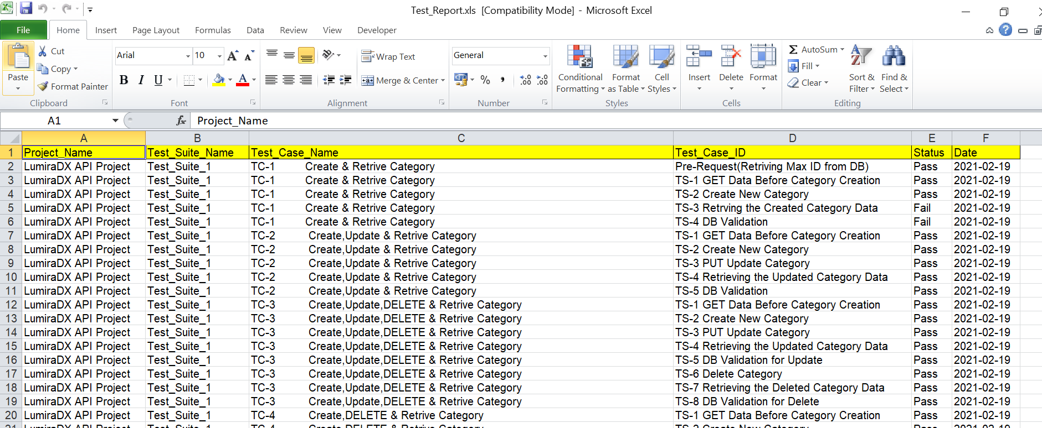
Auto-Generated test Report

Slide 7
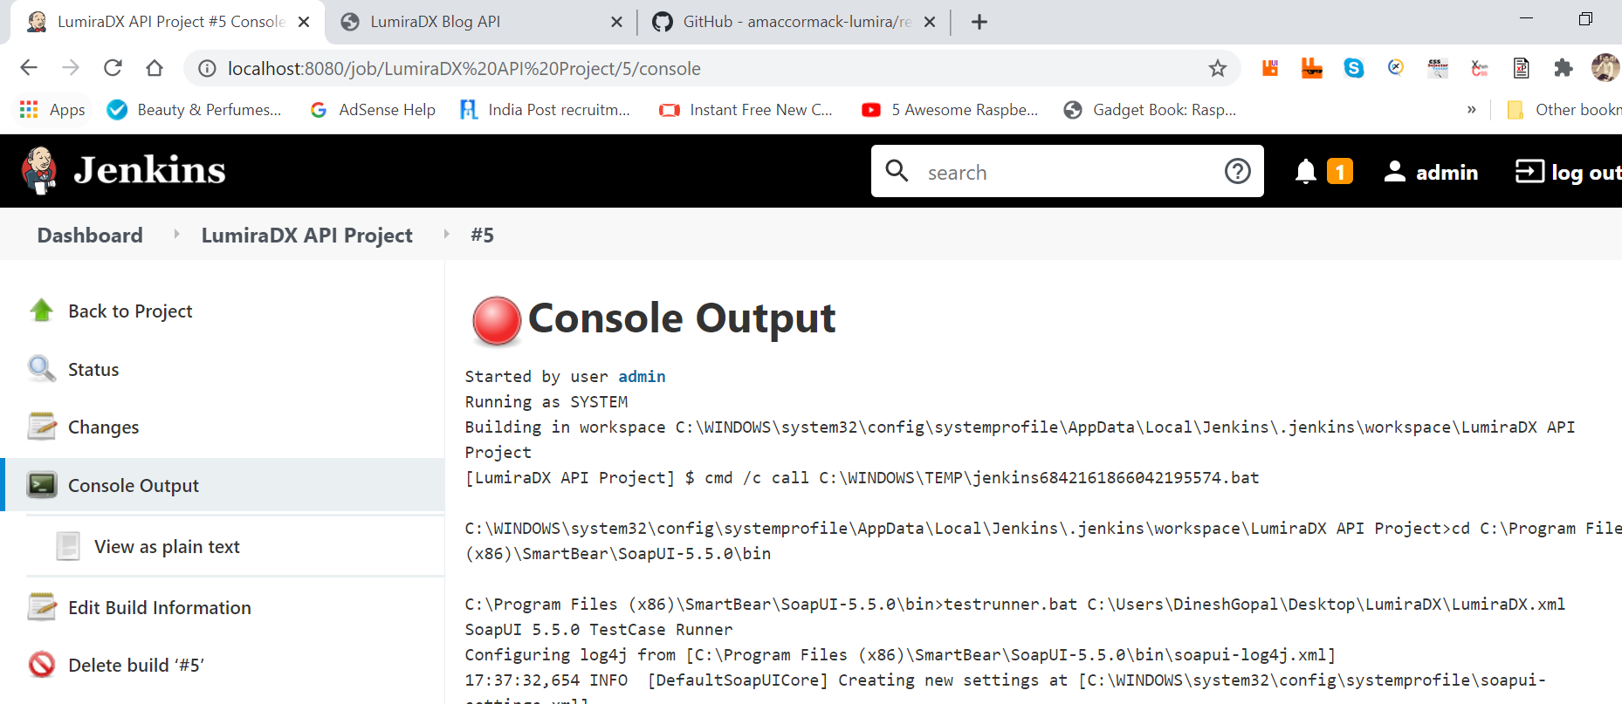
Jenkins Test Execution

Slide 8
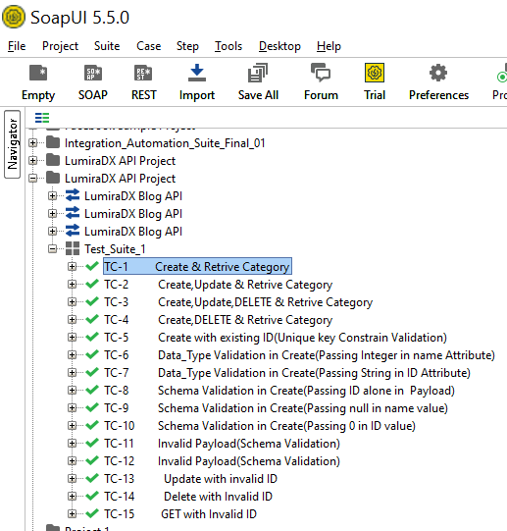
Test Suite with multiple Test case Execution in single click

Slide 9
Sample Test Script Validation
//grab the response
def ResponseMessage = messageExchange.response.responseContent
def TrimResponse =ResponseMessage.replaceAll('^\"|\"$','').replaceAll('^ \\[|\\]$','').replaceAll('\\\\','')
//define a JsonSlurper
def jsonSlurper = new JsonSlurper().parseText(TrimResponse)
//verify the Json isn't empty
assert !(jsonSlurper.isEmpty())
//Verify Id attribute
def Id = messageExchange.modelItem.testStep.testCase.testSuite.project.getPropertyValue('Id')
log.info Id
def A =(jsonSlurper.id).toString()
Response_Id = A.replace("","")
log.info Response_Id
assert Id == Response_Id
//Verify Name attribute
def name = messageExchange.modelItem.testStep.testCase.getPropertyValue('Data')
log.info name
def Response_name = jsonSlurper.name
log.info Response_name
assert name == Response_name

